Slide 1
Managing and Navigating WinRMS
Session 3: How to Manage the Noise in a Download
Erin Olsen, Supervisory Budget Analyst – St. Louis
Kari Points, Director Research Operations Iowa City
Antonio Laracuente, Director Field Operations - ORD
June 16, 2021

Slide 2
Objectives
4 Sessions
  TDAs – Allocations and Distributions including Prior Year – June 15
  Salary Management - June 16
  How to Manage the Noise in WinRMS – June 22
  Setting up Accounts, Expense Transfers and Split Account Transactions – June 23

Slide 3
Presenters
Antonio Laracuente – Director, Field Operations
Kari Points – Director Research Operations – Iowa City
Tabitha Randall – Supervisory Budget Analyst – Salt Lake City
Jamece Petteway – Supervisory Budget Analyst – Durham
Travis Peake – Supervisory Budget Analyst – Portland
Erin Olson – Supervisory Budget Analyst – St. Louis

Slide 4
Disclaimers and Thoughts
These are ideas that we are presenting to make WinRMS useful. If you have better ideas or ways to manage, please send those to any of us.
There are many ways to attack WinRMS however the presentations are based on the long term experiences of the users
Do not hesitate to contact any of us to help out
If you do not have WinRMS and would like it, please contact Kashif Iqbal or myself
It takes a few months to get WinRMS going at a station
The larger the station the more effective WinRMS is since it manages many accounts and control points
It takes daily management to make this work
You need to utilize other tools such as VSSC and IFCAP (VISTA) to reconcile and manage

Slide 5
Rules of Engagement
Download Noise is common in WinRMS
Noise comes from VISTA, FMS and PAID
You have to become an investigator (Sherlock Holmes) to understand why the noise happens and where it comes from
Fiscal Service causes quite a bit of the noise
PAID is the other major cause of noise

Slide 6
What is Noise
Noise is data that downloads into RMS but is not clear, is duplicative, or hits the wrong FCP because separation is impossible
Today we will focus on
  Alerts
  Reconciliation FMS to RMS
  FMS and vista dual entries
  Budget office adjustment
  Online FMS/VISTA adjustments
  Payroll
  Importance of Delegation logs

Slide 7
Types of Alerts
Data missing from download
  Group number – See last session on entering group numbers
  Account – from SubCP – critical to tracking expenses by project
  Employee no salary – download problem in system
  Employee missing (may be new)
No obligation number – not obligated yet

Slide 8
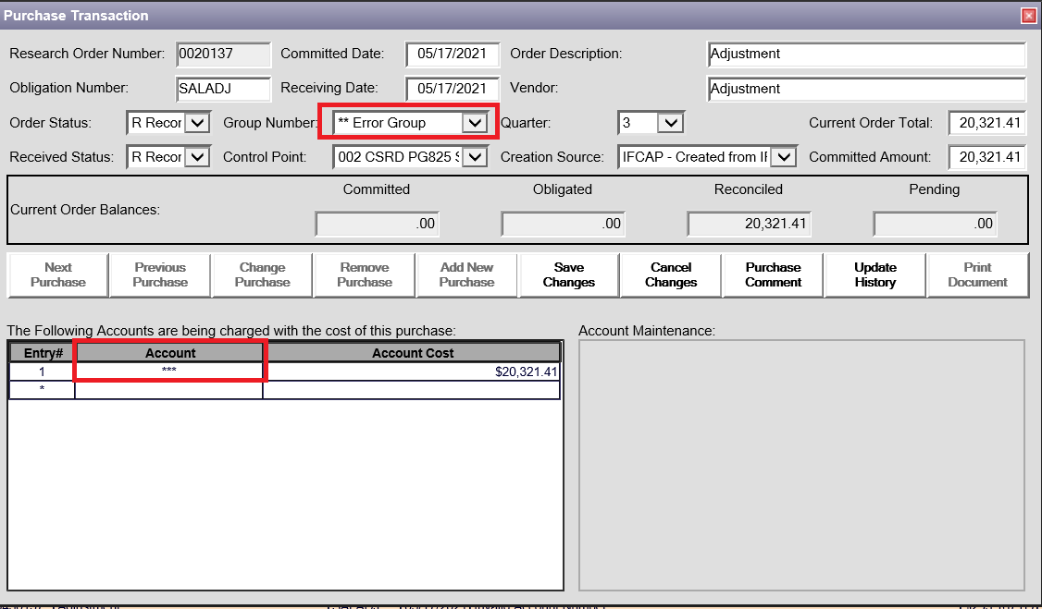
Correcting Group Numbers or Alerts
To avoid
  Need to make sure Group numbers are part of orders – see last training
  Enter the correct subCP
However, to correct go to alerts and open up

Slide 9
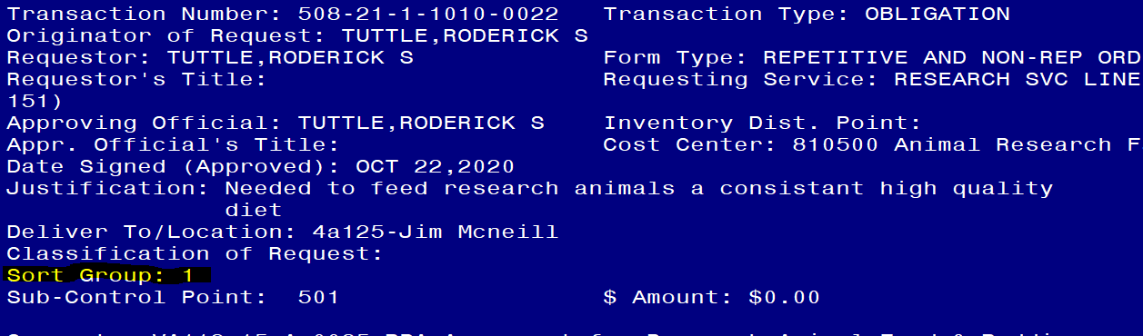

Slide 10
Reconcile FMS to RMS
It is extremely important to frequently balance your WinRMS FCP balances to FMS!
The size and complexity of your program can determine how often you do this. Each time you do a download, you should balance the FCPs. For salaries, you should be doing this each pay period.
In order to balance, you will need the Status of Allowance (SOA). There are couple ways to get this:
  From your Fiscal Office (Budgeting)
  From the VSSC: VSSC - VHA Support Service Center (va.gov)
Last session, I showed how to balance Salary FCPs so this session will focus on All Other FCPs. The method for balancing Ceilings is the same for all FCPs, but the expenses differ.

Slide 11
How to Balance All Other FCP
WINRMS pulls all obligated and pending transactions into the system. FMS only has obligated transactions. This causes challenges when balancing as you will need to factor in pending transactions.
The pending transactions can be found by looking at the IFCAP pending column if you receive the SOA from your Fiscal Office and they provide IFCAP balances, looking at the Total Commit, not Obl on your Running Balances in IFCAP, or by looking at your unreconciled orders and pending contracts.
You will need to know the pending transactions in order to budget.
To make this work, Fiscal must balance FMS and IFCAP and keep those systems up to date

Slide 12
How to Balance All Other FCP
To find the Total Expenses for each FCP in WINRMS, you can:
  Pull the Administrators Summary Report and look at the Account Expenditures report or
  On the home page, click on the FCP in yellow and select Summary Status or Detail Status in purple.
  Pull the Expenditures by FCP report
Let’s look at Iowa City’s FCP 4611 for All Other

Slide 13
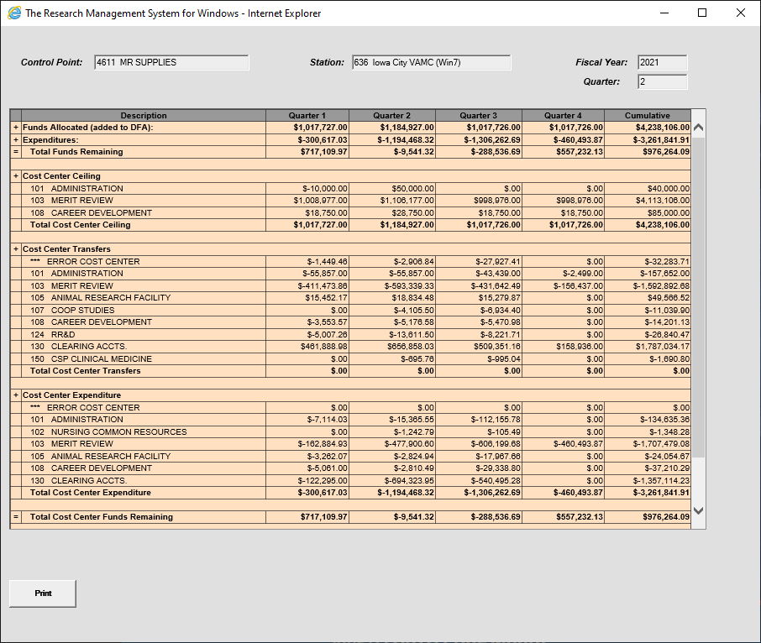
Detail Status Method

Slide 14
How to Balance All Other FCP
There is $3,261,841.91 in Expenditures for FCP 4611 in WinRMS
What does the SOA show?
  The SOA shows an obligated balance of $2,652,325.28
  Remember: The SOA only shows Obligated amount while WinRMS shows Obligated and Pending.
FCP | ACC | FCP Name | FMS Budget | FMS Oblig | FMS Unob
4611 | 8100101GB | 821 IC S&S 21/22 | 4,238,106.00 | 2,652,325.28 | 1,585,780.72

Slide 15
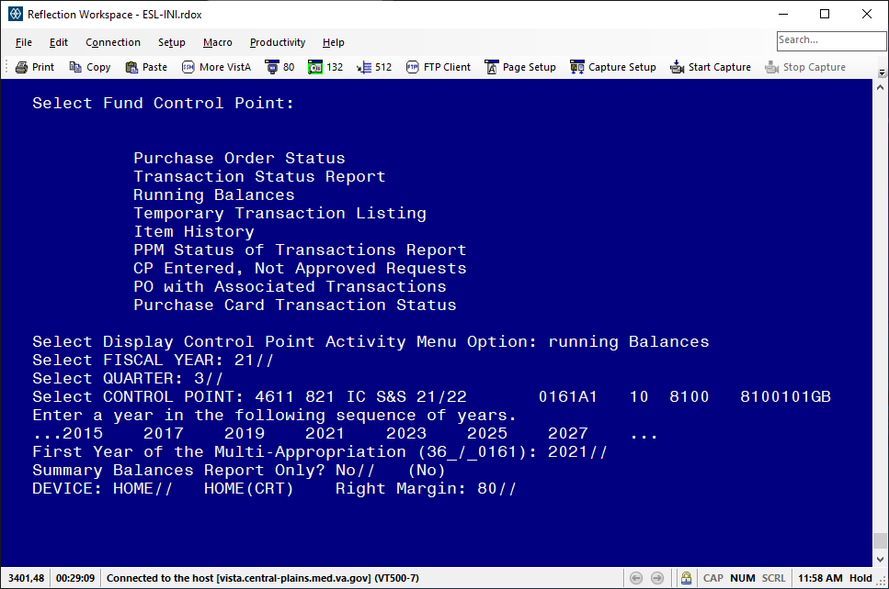
How to Balance All Other FCP
To find Pending transactions, you can go to the Running Balance Function in IFCAP

Slide 16
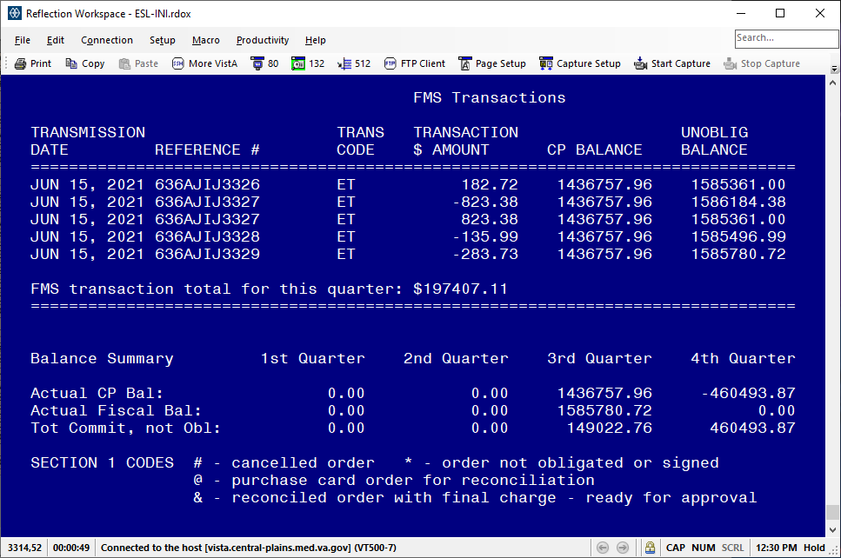
How to Balance All Other FCP
Hit Enter until you come to the end of the Running Balance report.
You will need the amounts in the Tot Commit, not Obl for the remaining Qtrs.

Slide 17
How to Balance All Other FCP
WinRMS Expenditures = $3,261,841.91
SOA Obligated = $2,652,325.28
IFCAP 3rd Qtr Pending = $149,022.76
IFCAP 4th Qtr Pending = $460,493.87
$2,652,325.28 + $149,022.76 + $460,493.87 = $3,261,841.91

Slide 18
What to do if you don’t balance?
If you do not balance, it is time to problem solve!
Places to look:
  Running Balance in IFCAP
  F20 Daily Activity Report in VSSC
  Check your Alerts in WinRMS – Is there noise that should be deleted?
  Check your Download Control report in WinRMS – What transactions downloaded? Do they match what the F20 and Running Balance in IFCAP show?
  Run a FCP report in WinRMS and compare to Running Balance in IFCAP and F20 Report
  Talk to your Purchasing Agents – Did they adjust a PO that didn’t update in WinRMS?
  Ask your Fiscal Office

Slide 19
Alerts
As soon as you complete a download, you need to check the Alerts.
You will need to figure out if these Alerts are transactions that need to be corrected or they need to be deleted.
2237 and 1358 transactions that have not been assigned a Purchase Order number yet by Contracting (2237) or Fiscal (1358) will show up in Alerts until the purchase order number is assigned. All other alerts should be dealt with.
An Alert may be that the sort group code or account number may not have been entered. This will need to manually be corrected.

Slide 20
How to Prevent Noise
How can you prevent some of the Alerts? Check the FMS Transaction Codes that you are downloading! Go to Find - > Find FMS Transaction Code
  This will give you a list of FMS transaction codes that are available to download. You want to look at what you are downloading to see if you can eliminate some of the Noise.
  You can update the list by selecting the FMS Code and then change the Update to RMS (Y/N).
  This next slide shows the recommendation for codes that you want to download.

Slide 21
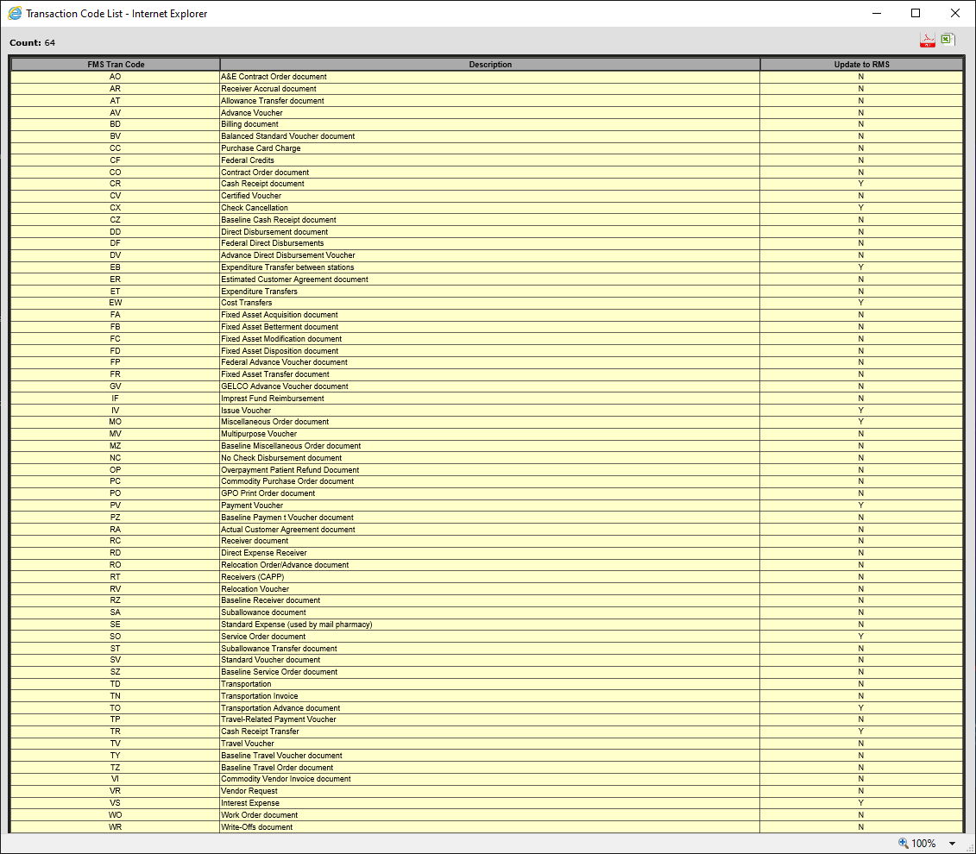
Find>FMS Transaction Code

Slide 22
Say Yes to Only a Few
CR, CX, EB, EW, IV, MO, PV, SO, TO, TR, VS
These are usually online transactions that hit only FMS. MO and SO will hit IFCAP but may have online adjustments

Slide 23
FMS Codes – Example of Noise
The description of the code in WinRMS may not always be clear on what the item is that downloaded.
For example:
  The code TR in WinRMS is described as “Cash Receipt Transfer”
  What does that actually mean??? This is your purchase card rebate.
  The purchase card rebate will download into WinRMS due to this code being selected for downloading. When the purchase card rebate downloads, it is not clear that is what the transaction is. The transaction will show up in alerts as items such as sort group and account number will need to be manually entered. To find out that it is a purchase card rebate, you can also look the order up on your F20 and it will show the transaction as TR indicating purchase card rebate.

Slide 24
FMS and VISTA
Sometimes transactions hit both FMS and VISTA
  end of year fiscal will obligate online
  Online adjustments to orders
You have to make sure that when you get an FMS transaction that downloads that it is not duplicated

Slide 25
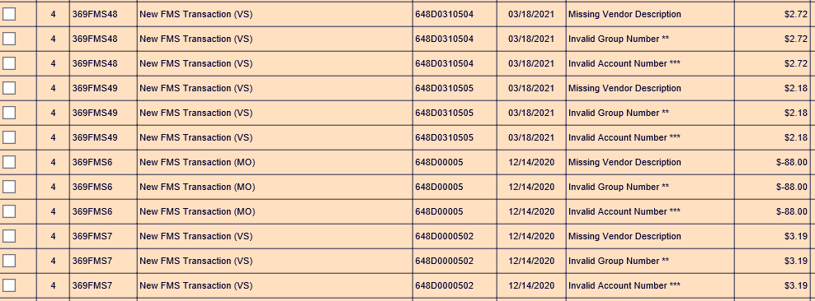
VISTA and FMS Dual Entries
In some instances, FMS and VISTA create dual entries for VS, SO and MO transactions.
Once you have validated the charges in FMS, you need to make sure that it is not duplicated in VISTA. If it is, Delete. If not, you can update with the correct info.
You will also note that there are interest payments here that need to be updated (VS).

Slide 26
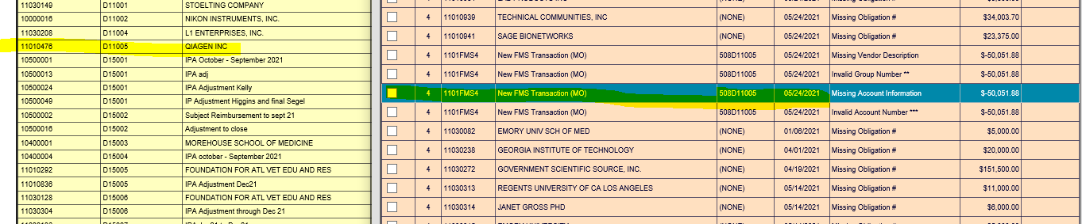
Order already in system
Delete the FMS Transaction

Slide 27
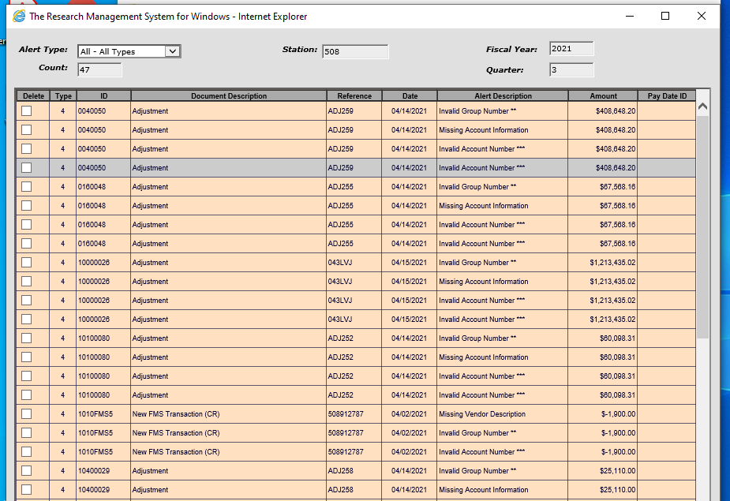
Budget Office Adjustments
Budget will sometimes balance by putting an entry into IFCAP. These do not go into FMS but verify in the F20. If not in FMS, Delete the transaction.

Slide 28
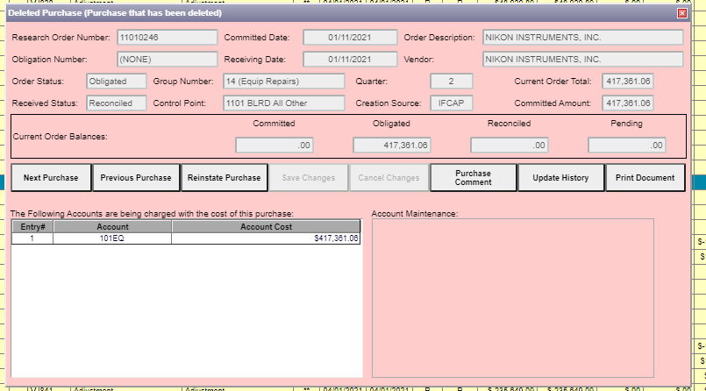
What Happens if you Delete Incorrectly
Do not Panic
Go to Find > Find Deleted Purchase
Select purchase
Reinstate purchase

Slide 29
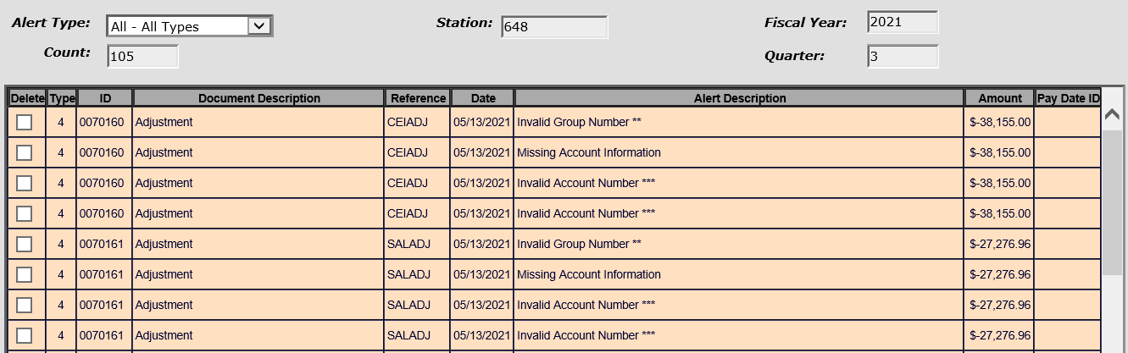
Payroll and Paid
Every pay period when payroll processed it is deducted from FMS. The Fiscal budget office then creates a ceiling adjustment to offset VISTA. Because you download the actual per person payroll from PAID through VISTA, these transactions can be deleted.

Slide 30
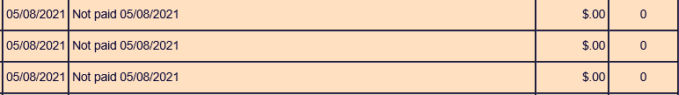

Payroll Alerts
There are two main categories of payroll alerts.
Not paid: The employee has been terminated or appointment has ended. Verify with your administrative officer/Human resources office.
Once you have verified that the employee has been terminated. Click on the alert with their name.
In the upper righthand corner choose the appropriate date and save.

Slide 31
Payroll Alerts
2. Pay Not Posted Name, Pay Plan not found: This is a new employee that will need to be established in WinRMS. There are 3 categories to choose from:
A. Employee number
B. Add New Employee
C. Select from the list on the right-hand side.

Slide 32
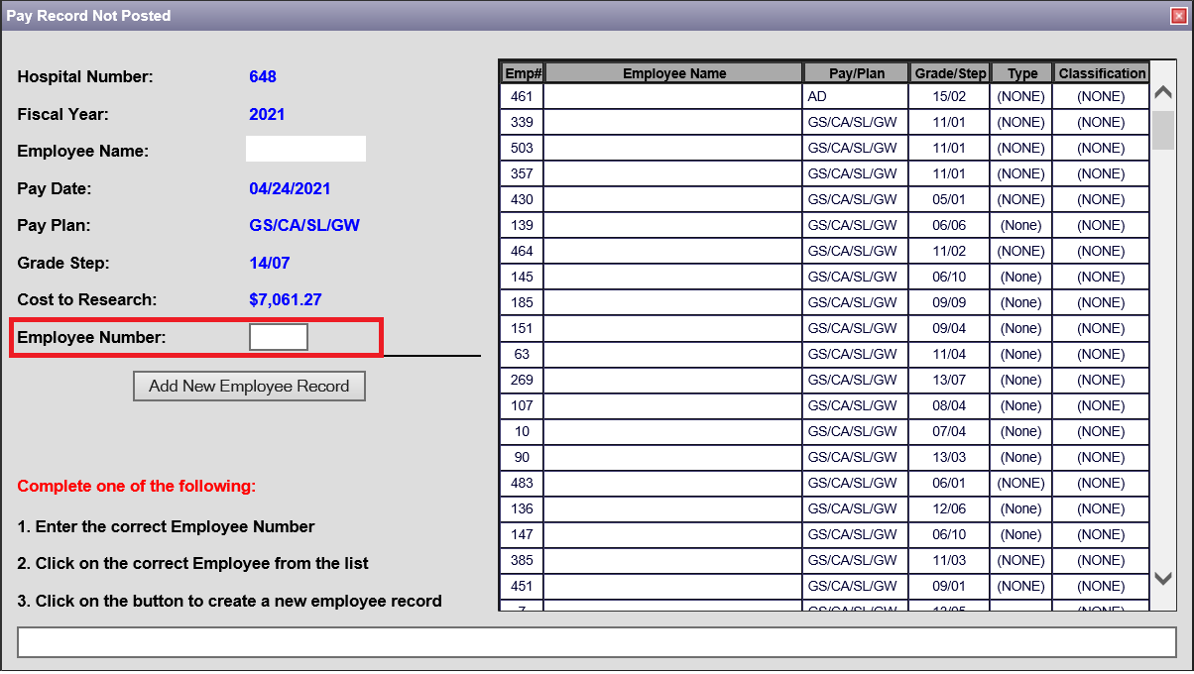
Payroll Alerts
A. Employee number: If you know this employee or you can find them on the list on the right, you can enter the number and hit enter.

Slide 33
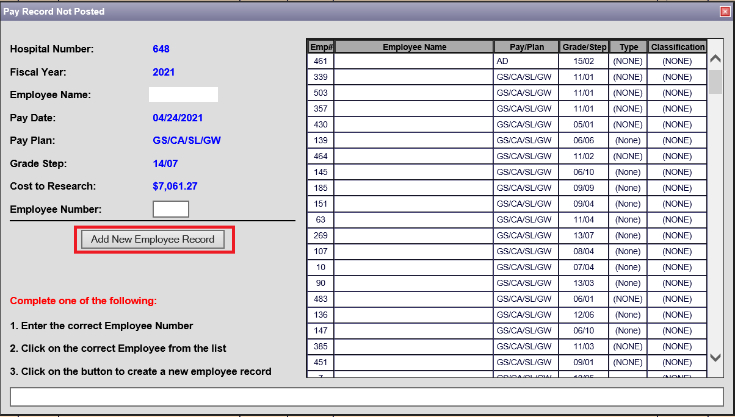
Payroll Alerts
B. Add Employee: Start by clicking the Add New Employee Record button.

Slide 34
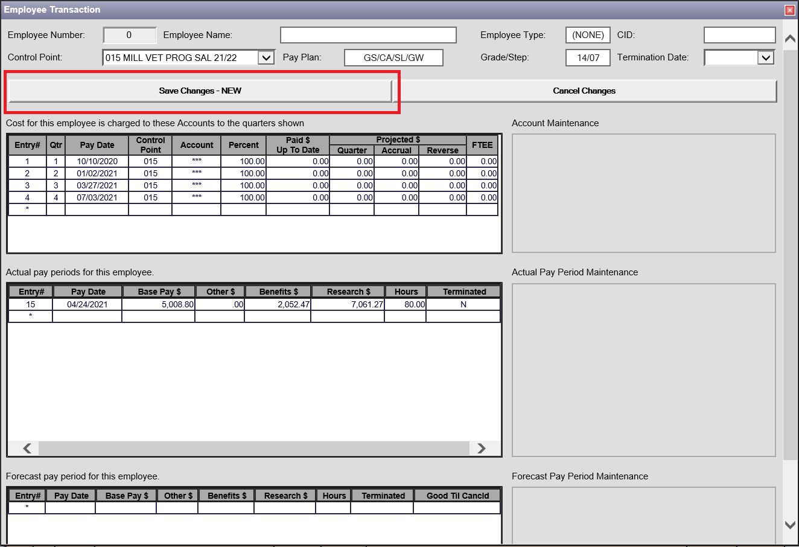
Payroll Alerts
B. Add Employee Cont.: Once you have validated the account and FCP you can select save.

Slide 35
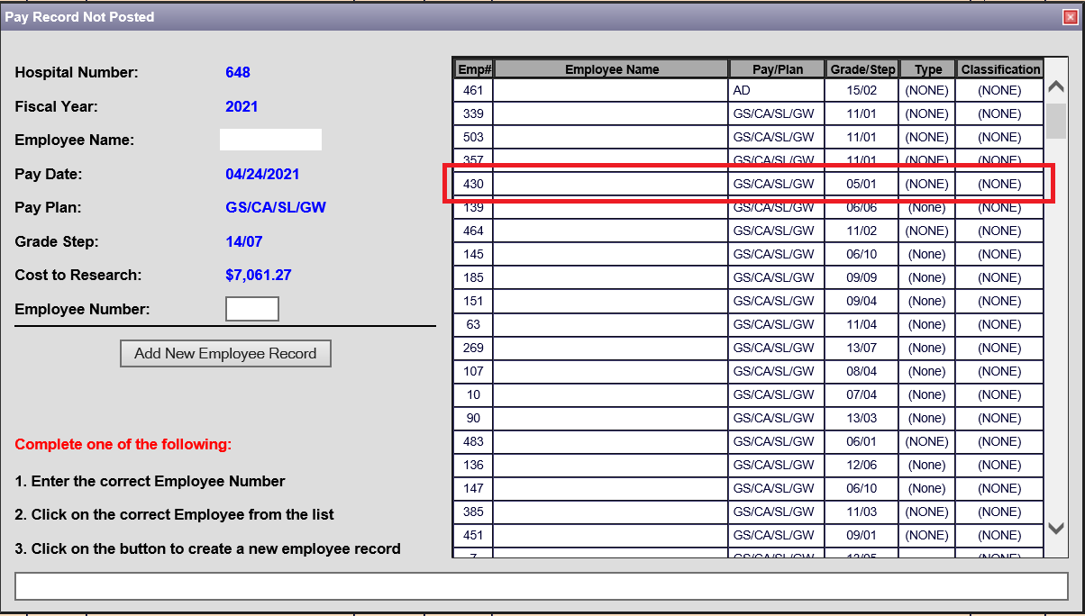
Payroll Alerts
C. Select employee from the right-hand side and save.

Slide 36
Delegation Logs
Delegation of Authority is managed by Fiscal Service and the process may vary across stations.
Important to make sure that people using WinRMS have appropriate access to the FCPS in order to download
Impacts VISTA, PAID and FMS downloads

Slide 37
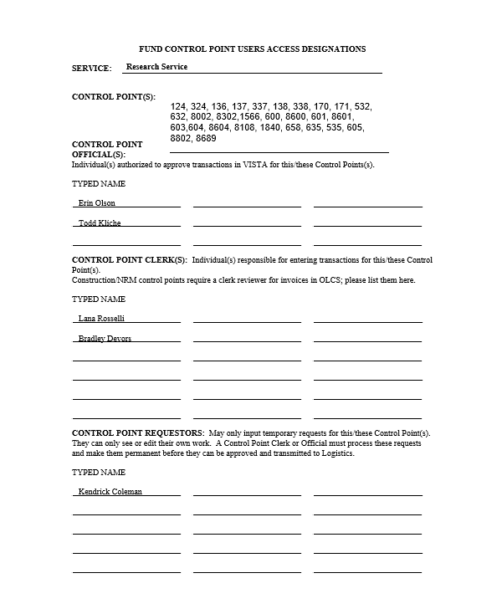
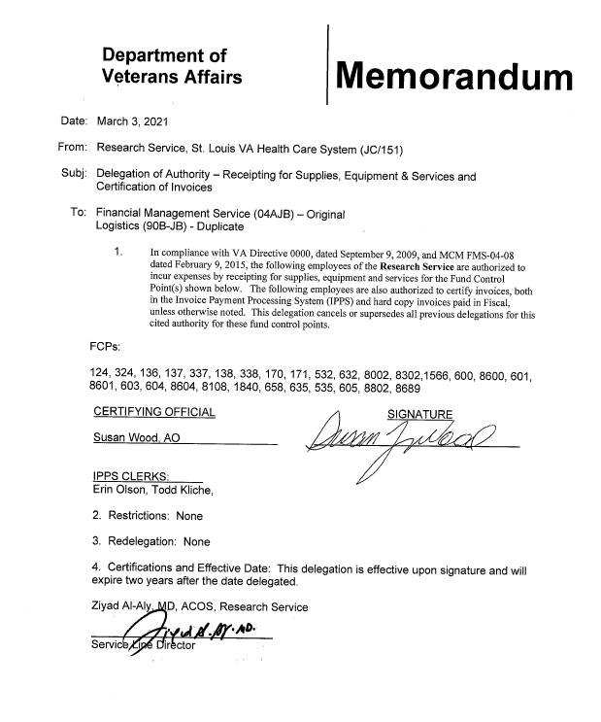
Delegation Logs
Your fiscal service manages access to fund control points
Delegation logs designate roles in VISTA and IPPS
List all FCPs you use on your delegation log
Separation of duties are maintained; those entering transactions cannot approve transactions for example
Recommend at least one backup
FCPs on your delegation log should be entered into WinRMS

Slide 38
Conclusions
Noise comes from a variety of sources
You need to balance or reconcile frequently
Download every few days and clean up the Alerts
Reconcile each PP
Update what to download from FMS based on FMS Transaction Codes
If you do not balance, you need to look for the anomalies
Use VSSC tools such as the F20 to help you

Slide 39
Availability of Recording
A recording of this session and the associated handouts will be available on ORPP&E’s Education and Training website approximately one-week post-webinar
An archive of this and other webinars can be found here: https://www.research.va.gov/programs/orppe/education/webinars/archives.cfm

Slide 40
Questions??

